Slide 1

THINKING AND ANALYSIS
SESSION II

Slide 2
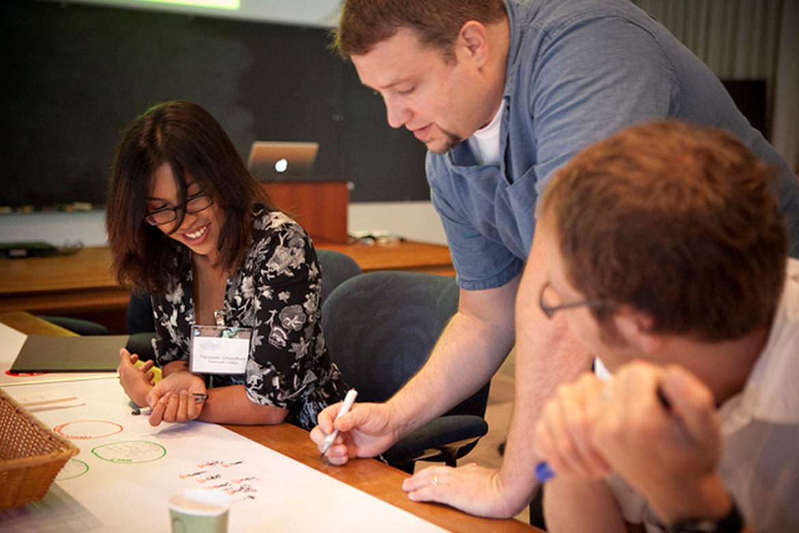
Chapter outlines
4. Critical Thinking Skills

Slide 3
LEARNING OBJECTIVES
By the end of this section, you will be able to:
Define critical thinking
Describe the role that logic plays in critical thinking
Describe how critical thinking skills can be used to problem-solve
Describe how critical thinking skills can be used to evaluate information
Identify strategies for developing yourself as a critical thinker

Slide 4
What Is Critical Thinking?
Critical thinking is clear, reasonable, reflective thinking focused on deciding what to believe or do.
It involves being skeptical and challenging assumptions, rather than simply memorizing facts or blindly accepting what you hear or read.
Asking probing questions like:
“How do we know?”
“Is this true in every case or just in this instance?”

Slide 5
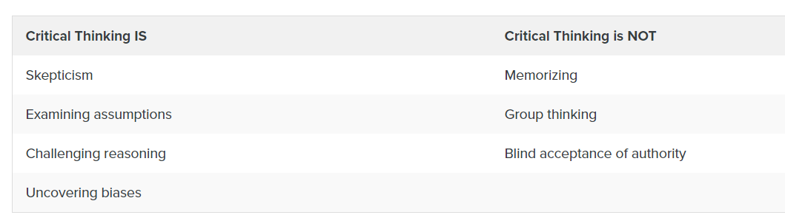

Slide 6
ACTIVITY: SELF-ASSESS YOUR CRITICAL THINKING STRATEGIES
Objectives
Assess your basic understanding of the skills involved in critical thinking.
Directions
Visit the Quia Critical Thinking Quiz page and click on Start Now (you don’t need to enter your name). Select the best answer for each question, and then click on Submit Answers. A score of 70 percent or better on this quiz is considering passing.
Based on the content of the questions, do you feel you use good critical thinking strategies in college? In what ways might you improve as a critical thinker?

Slide 7
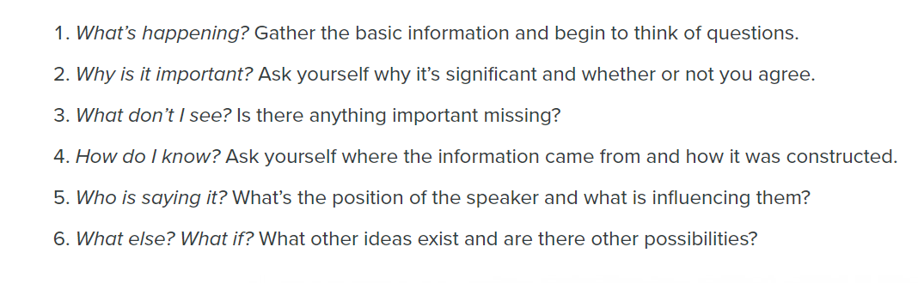
Critical Thinking and Logic
Questions of Logic in Critical Thinking

Slide 8
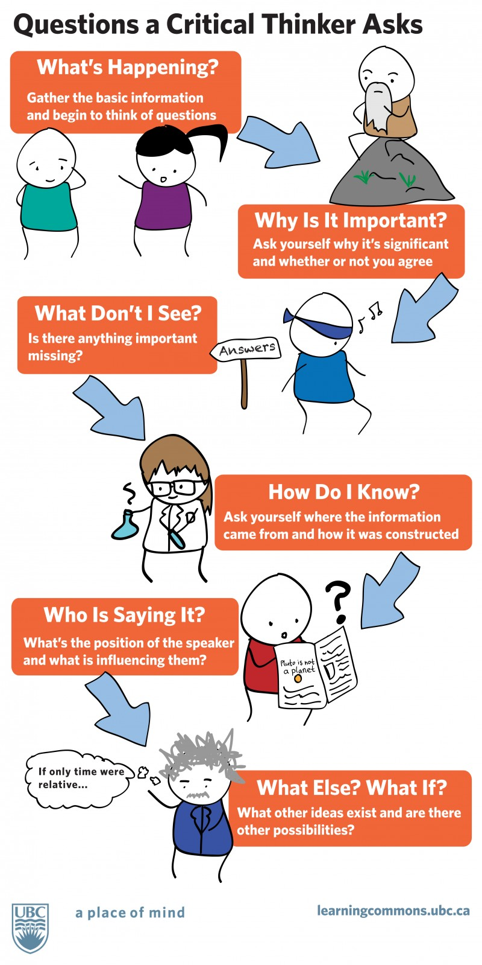

Slide 9
Problem-Solving with Critical Thinking
Critical thinking and problem-solving go hand-in-hand
Rrefer to using knowledge, facts, and data to solve problems effectively.

Slide 10
Using critical thinking to problem-solve:
Your roommate was upset and said some unkind words to you, which put a crimp in the relationship. You try to see through the angry behaviors to determine how you might best support the roommate and help bring the relationship back to a comfortable spot.
Your campus club has been languishing on account of lack of participation and funds. The new club president, though, is a marketing major and has identified some strategies to interest students in joining and supporting the club. Implementation is forthcoming.
Your final art class project challenges you to conceptualize form in new ways. On the last day of class when students present their projects, you describe the techniques you used to fulfill the assignment. You explain why and how you selected that approach.

Slide 11
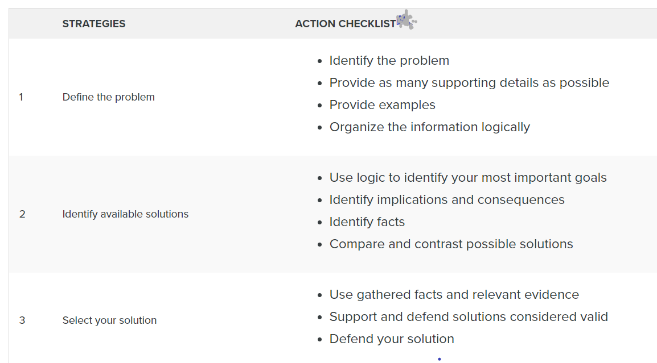
Problem-Solving Action Checklist

Slide 12
Evaluating Information with Critical Thinking
Read for understanding by using text coding
Examine arguments
Clarify thinking
Cultivate “habits of mind”
Evaluating information can be one of the most complex tasks.
But if you utilize the following four strategies, you will be well on your way to success:

Slide 13
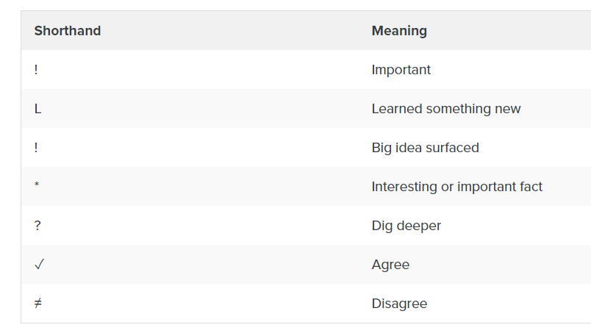
A. Read for Understanding Using Text Coding
Text coding is a way of tracking your thinking while reading
With text coding, mark important arguments and key facts
See more text coding from PBWorks and Collaborative for Teaching and Learning.

Slide 14
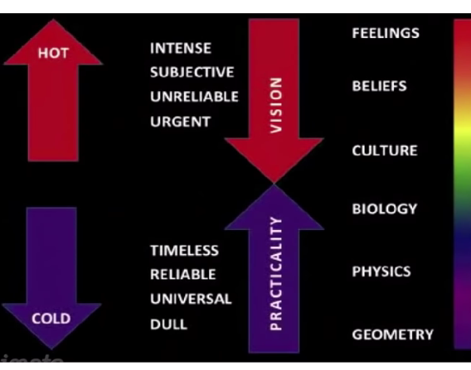
B. Examine Arguments
Use the spectrum of authority strategy:
https://youtu.be/9G5xooMN2_c

Slide 15
C. Clarify Thinking
What is the purpose?
What question are we trying to answer?
What point of view is being expressed?
What assumptions are we or others making?
What are the facts and data we know, and how do we know them?
What are the concepts we’re working with?
What are the conclusions, and do they make sense?
What are the implications?
When you use critical thinking to evaluate information, you need to clarify your thinking to yourself and likely to others.

Slide 16
D. Cultivate “Habits of Mind”
Do you approach problems with an open mind, a respect for truth, and an inquiring attitude?
“Habits of mind” are the personal commitments, values, and standards you have about the principle of good thinking.

Slide 17
Try to work these qualities into your daily life:
being receptive to having your opinions changed
having respect for others
being independent
not accepting something is true until you’ve had the time to examine the available evidence
being fair-minded
having respect for a reason
having an inquiring mind
not making assumptions
questioning your own conclusions

Slide 18
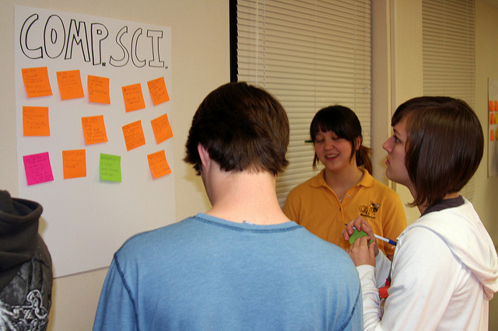
Developing Yourself As a Critical Thinker
Reflect and practice
Use wasted time
Redefine the way you see things
Analyze the influences on your thinking and in your life
Express yourself
Enhance your wellness:
Try taking 10-minute activity breaks to reach 30 to 60 minutes of physical activity each day.

Slide 19
Practice: Evaluation of project ideas "Social Initiatives"
Use critical thinking skills to challenge other groups' social initiatives ideas (from activity 1 of Creative Thinking Skills)
Point out weaknesses and difficulties in implementing ideas in life

Slide 20
